Slide 1

EV Charging Analytics Platform
End-to-End Data Engineering & Machine Learning Pipeline
Durgaprasad Vamsi, Veera, Yashas

Slide 2

Problem Statement
EV charging networks generate large volumes of real-time session data
Businesses need analytics for revenue forecasting and operational insights
Traditional systems struggle with real-time + batch integration
Need scalable cloud-based architecture for streaming and ML

Slide 3
Project Objective
Build complete cloud-based EV charging analytics system
Implement real-time streaming pipeline
Perform batch aggregation using Airflow
Store data in BigQuery warehouse
Train ML model to predict total revenue
Monitor system performance and reliability

Slide 4
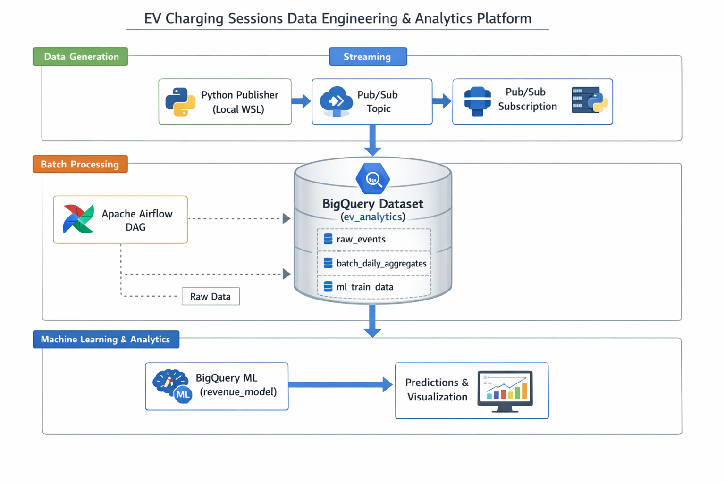
Architecture Overview
Data Generation (Python EV session simulator)
Local Streaming (Kafka)
Cloud Streaming (Google Pub/Sub)
Batch Processing (Apache Airflow)
Data Warehouse (BigQuery – ev_analytics)
Machine Learning (BigQuery ML – Linear Regression)
Visualization & Monitoring

Slide 5
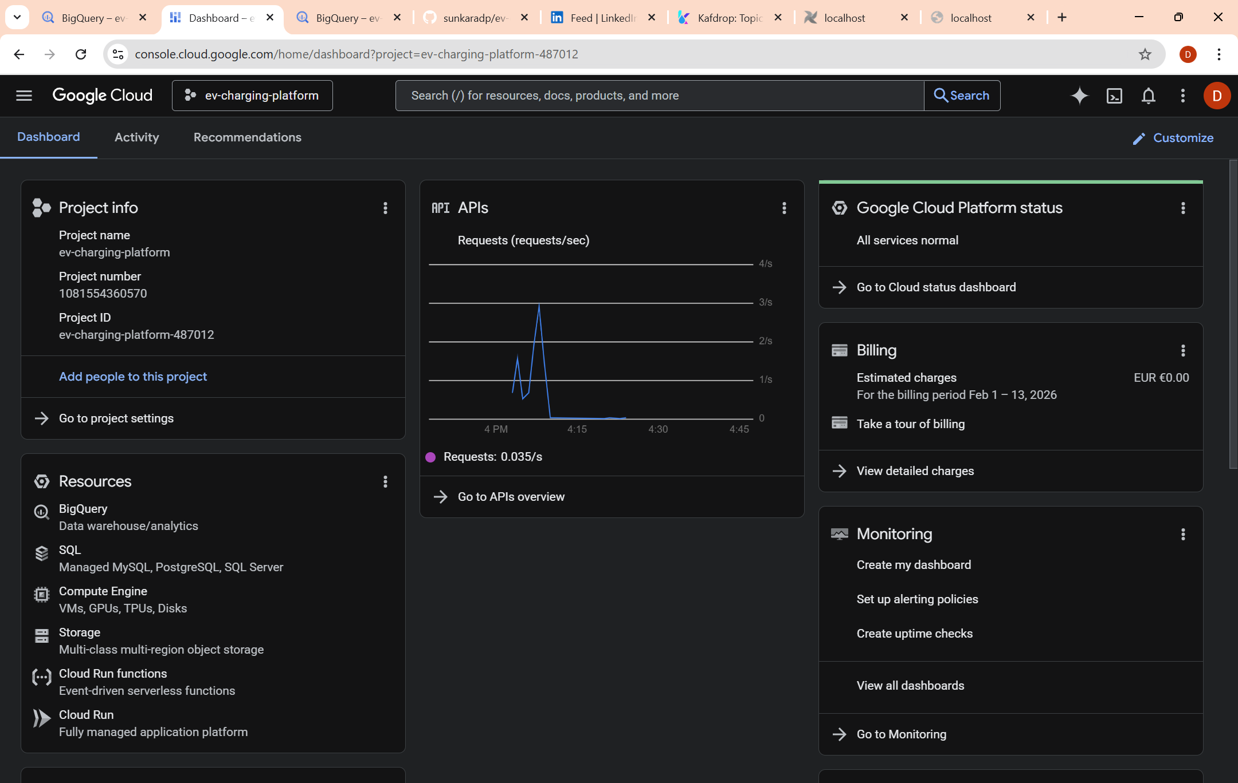
Durga - Cloud Architecture & BigQuery Layer
Configured GCP project and enabled APIs
Pub/Sub
BigQuery
Cloud Storage
Vertex AI
Cloud Logging
Created BigQuery dataset: ev_analytics
Loaded batch outputs into BigQuery
Designed ml_train_data table
Created and trained revenue_model using BigQuery ML
Evaluated prediction accuracy

Slide 6
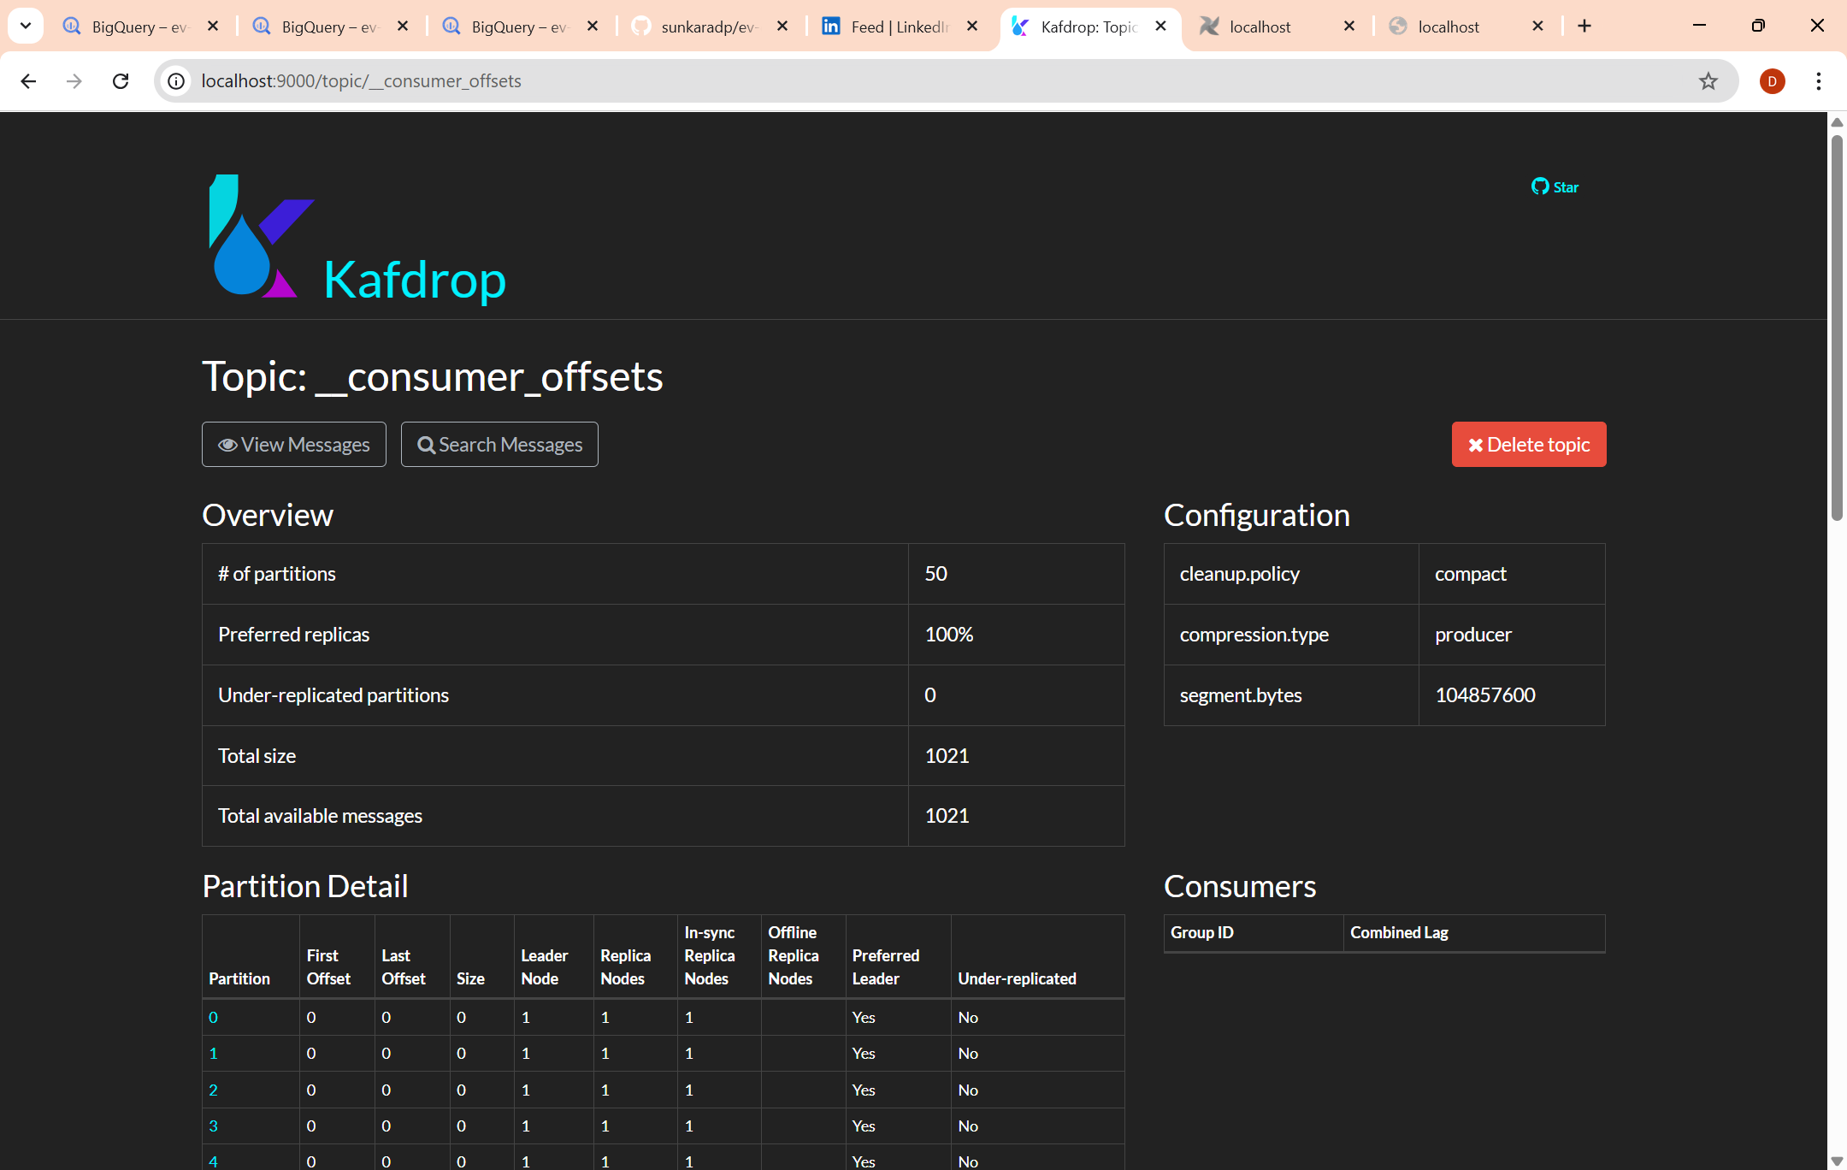
Vamsi - Kafka
Kafka Local Streaming Layer
Deployed Kafka & Zookeeper using Docker Compose
Created Kafka topic: ev-charging-sessions
Developed producer to simulate EV charging events
Implemented consumer to validate real-time ingestion
Monitored topics and partitions using Kafdrop
Resolved Docker networking and container issues

Slide 7
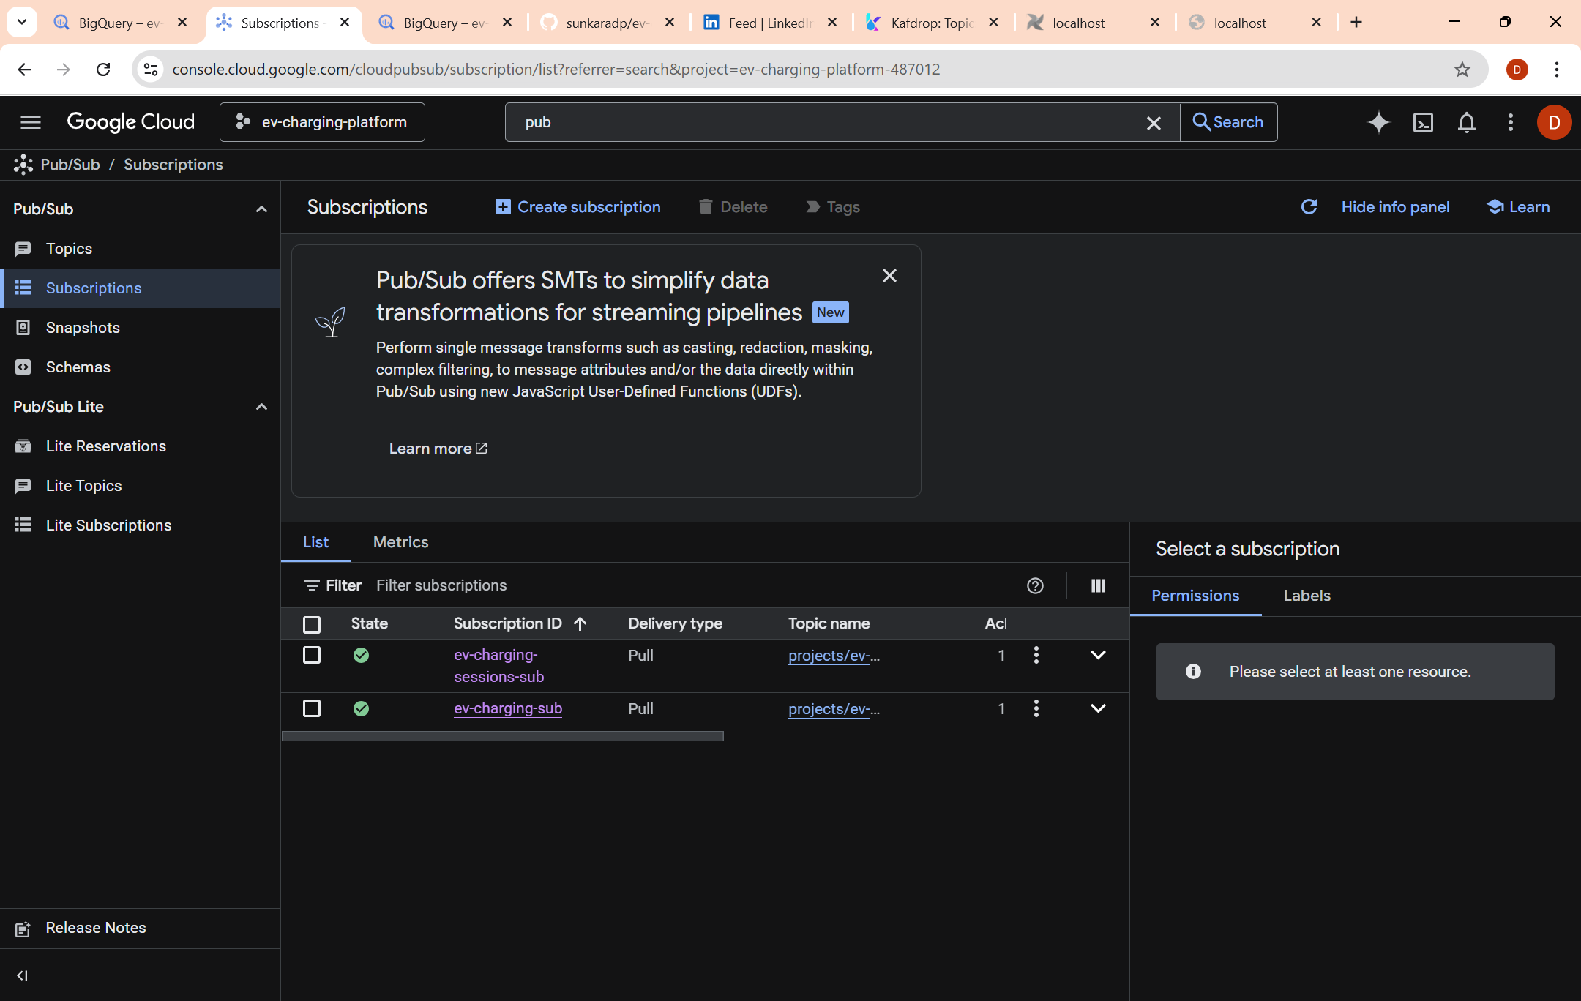
Veera - Streaming
Pub/Sub Cloud Streaming Integration
Created Pub/Sub topic and subscription
Configured IAM roles (Publisher & Subscriber)
Generated service account key for authentication
Integrated publisher using GOOGLE_APPLICATION_CREDENTIALS
Validated real-time message delivery in cloud
Resolved IAM and permission errors

Slide 8
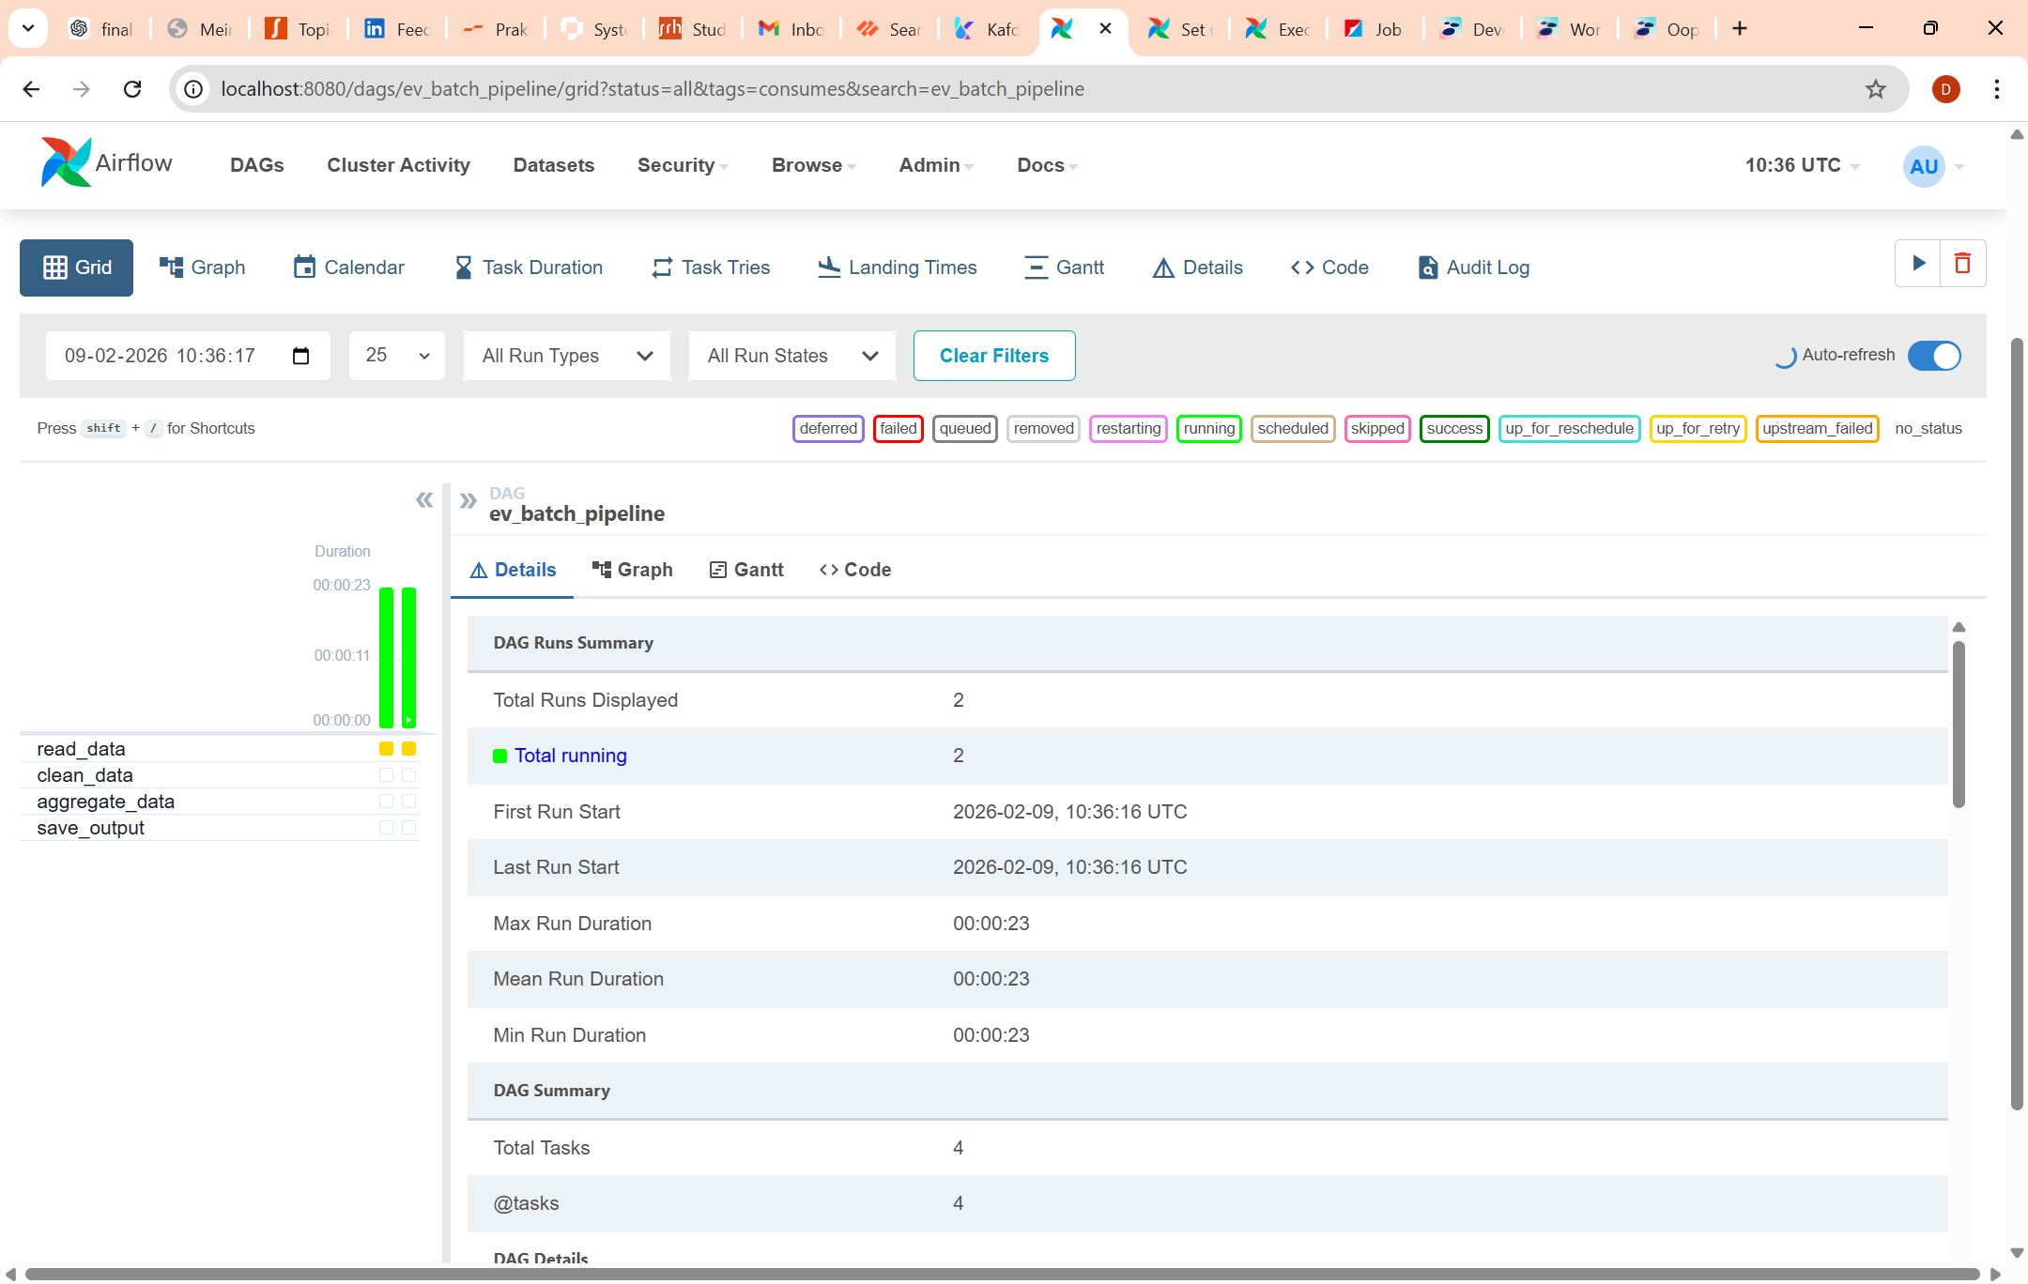
Yashas- Batch Processing
Batch Processing & Orchestration (Airflow)
Designed DAG: ev_batch_pipeline
Implemented pipeline:
Read raw data
Clean and validate
Aggregate metrics
Save output
Generated batch_daily_aggregates table
Configured Airflow scheduler & webserver
Validated successful DAG execution

Slide 9
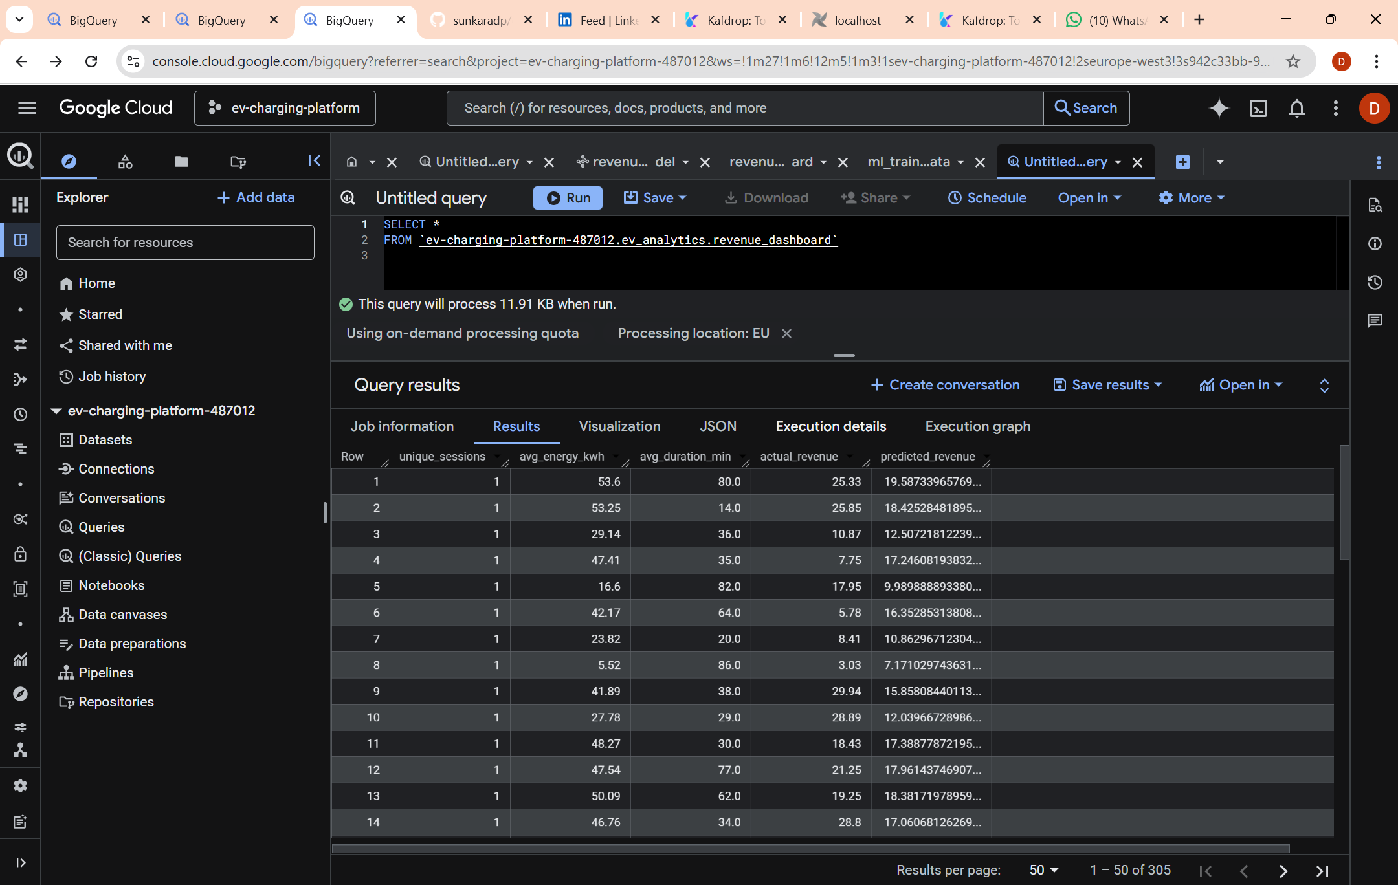
Data Warehouse (BigQuery)
Dataset: ev_analytics
Tables:
batch_daily_aggregates
ml_train_data
Model:
revenue_model
SQL-based transformation for feature engineering
Cloud-native scalable analytics layer

Slide 10

Machine Learning Model
Model Type: Linear Regression
Features:
unique_sessions
avg_energy_kwh
avg_duration_min
Target:
total_revenue_eur
Model Formula:
Y = β₀ + β₁X₁ + β₂X₂ + β₃X₃ + ε
Trained using BigQuery ML
Evaluated using RMSE, MAE, R²

Slide 11
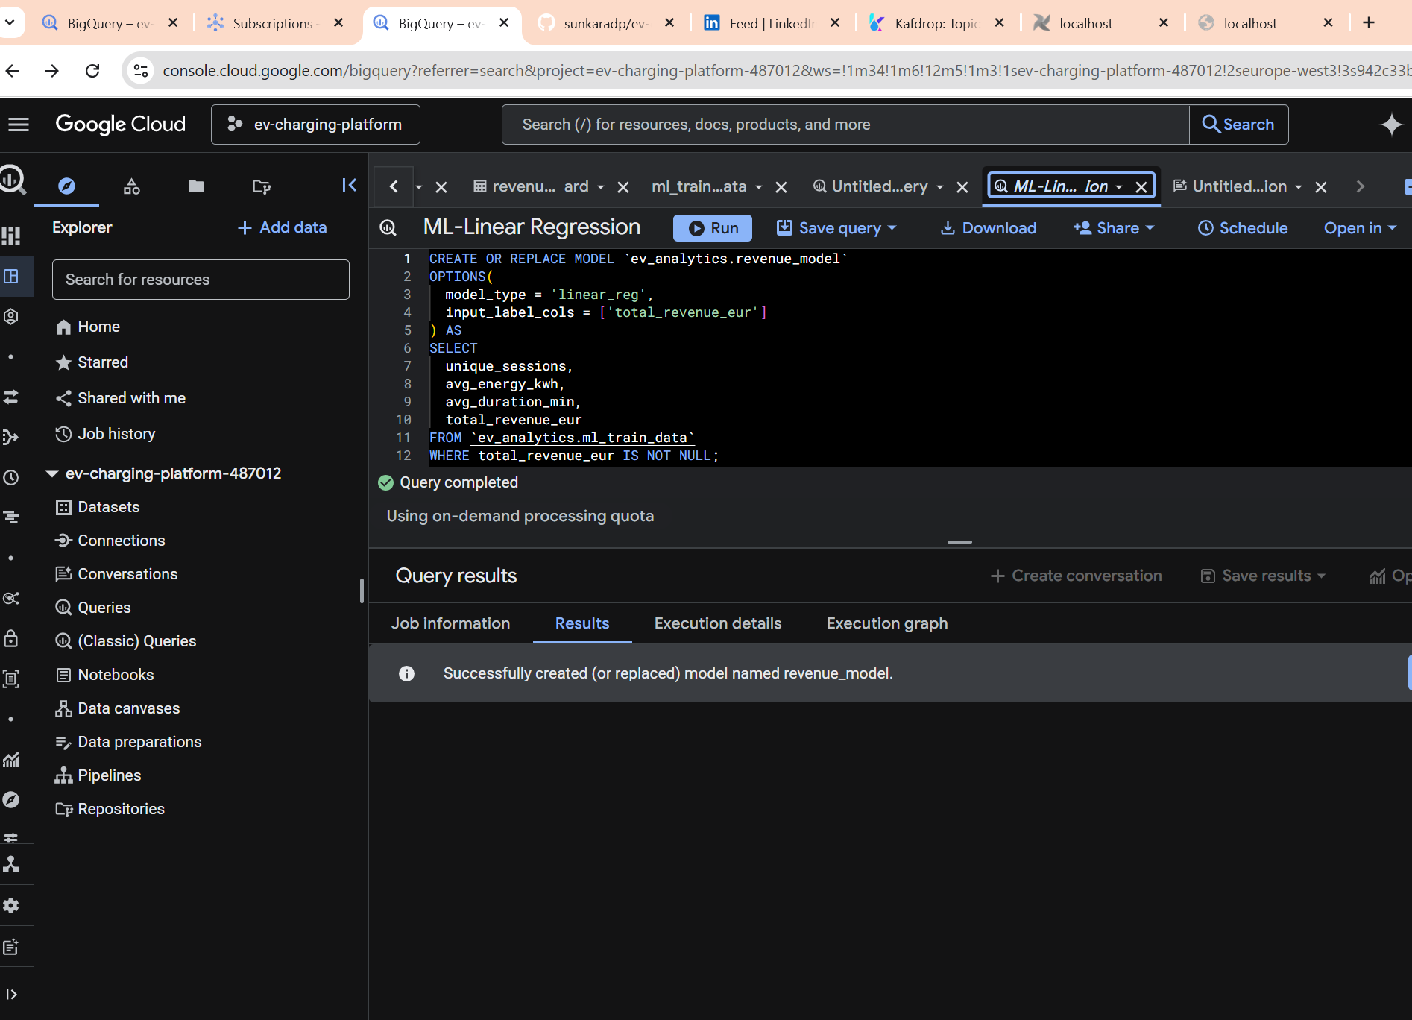
Revenue Prediction
Used ML.PREDICT() in BigQuery
Generated predicted_total_revenue_eur
Compared predicted vs actual revenue
Visualized results using BigQuery Studio
Enables data-driven revenue forecasting

Slide 12
Monitoring & Validation
Docker container health monitoring (docker ps)
Kafka monitoring via Kafdrop UI
Pub/Sub log validation
BigQuery Job History monitoring
ML training metrics and evaluation
Ensures system reliability and correctness

Slide 13
Mathematical Perspective
Regression minimizes Mean Squared Error (MSE)
MSE = (1/n) Σ (Y − Ŷ)²
High R² indicates strong predictive accuracy
System stability analyzed using streaming throughput

Slide 14

Challenges Faced
Pub/Sub authentication errors
Docker networking conflicts
Airflow scheduler configuration issues
Schema mismatch in SQL queries
Streaming synchronization timing
All resolved through proper configuration and debugging

Slide 15
Conclusion
Successfully built end-to-end EV analytics pipeline
Integrated streaming, batch, cloud warehouse & ML
Demonstrated real-time ingestion & revenue prediction
Scalable architecture suitable for production extension

